Slide 1
Random number generators for hardware GP using FPGAs and Handel-C
Peter Martin
University of Essex, UK

Slide 2
Introduction
Motivation
Field Programmable Gate Arrays (FPGAs) and Handel-C
Random Number Generators
Results
Conclusions

Slide 3
Motivation
GP implemented in hardware using FPGA
Characterise the affect of random number generator originally used (LFSR)
Compare different hardware generators
Previous work by Meysenburg and Foster (1999 GECCO).

Slide 4
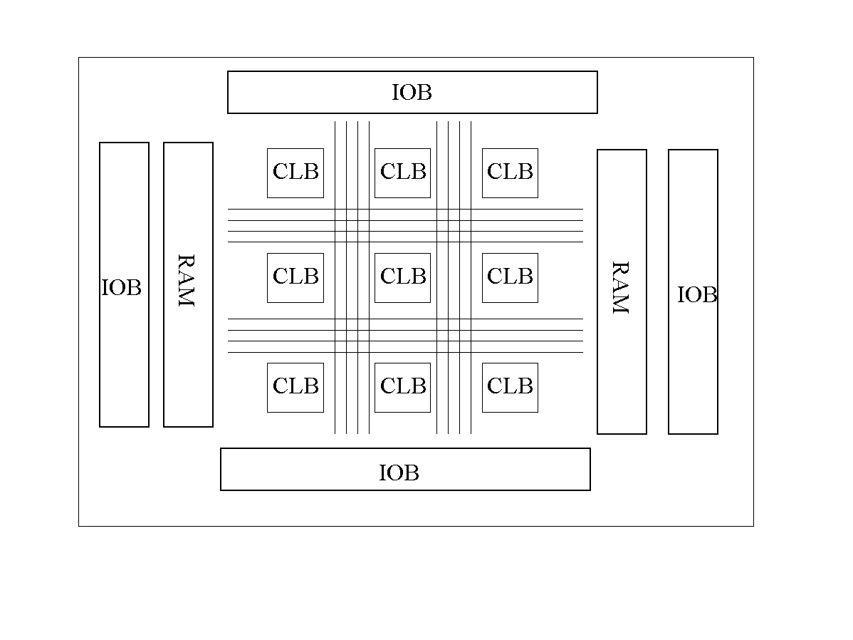
FPGAs
Re-configurable arrays of logic cells
Programmable logic functions
Flexible routing
On-chip memory

Slide 5
Handel-C
High level language to FPGA system
C-like syntax
Extensions for parallelism
    unsigned int 5 a,b;
    par {
    a = 10;
    b = 20;
    }
Predictable timing semantics

Slide 6
Random Number Generators
Linear Feedback Shift Register
Cellular Automata
True random sequences
Multiplicative/additive generators
Non-random sequences

Slide 7
LFSR
Efficient to implement in hardware
Single shift fails serial test
Multiple shifts give better results

Slide 8
Cellular Automata
Efficient to implement in hardware
Single CA give poor serial test results
Multiple CAs give better results

Slide 9
True Random Sequences
Noise from:
  atmospheric radio noise
  radioactive decay
  electronic circuit noise
Slow
Require specialised hardware

Slide 10
Multiplicative/additive Generators
Popular in software implementations
Simple generators do not perform well
  e.g. example from K&R
Inefficient to implement in hardware
  multiply, divide and modulus operators
  deep combinatorial logic using Handel-C

Slide 11
Non-random sequences
Very simple to implement
….

Slide 12
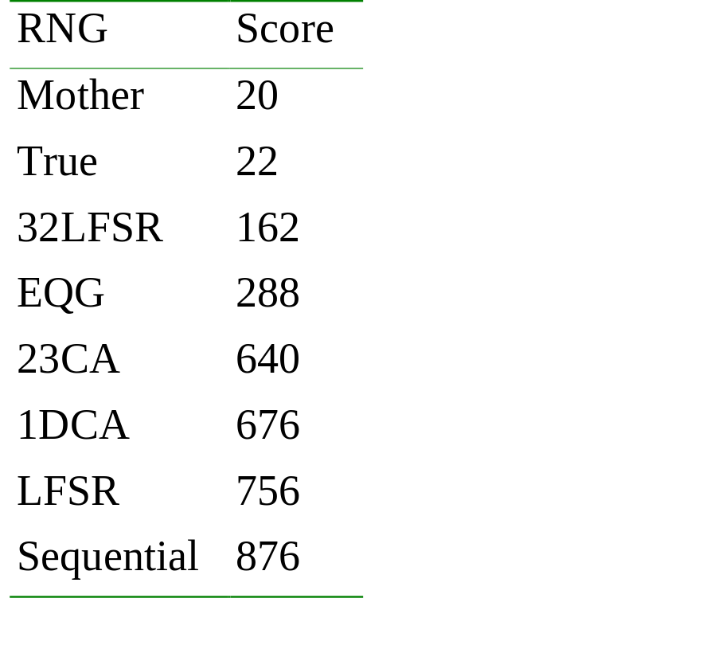
Results - Diehard
Worst possible score = 876

Slide 13
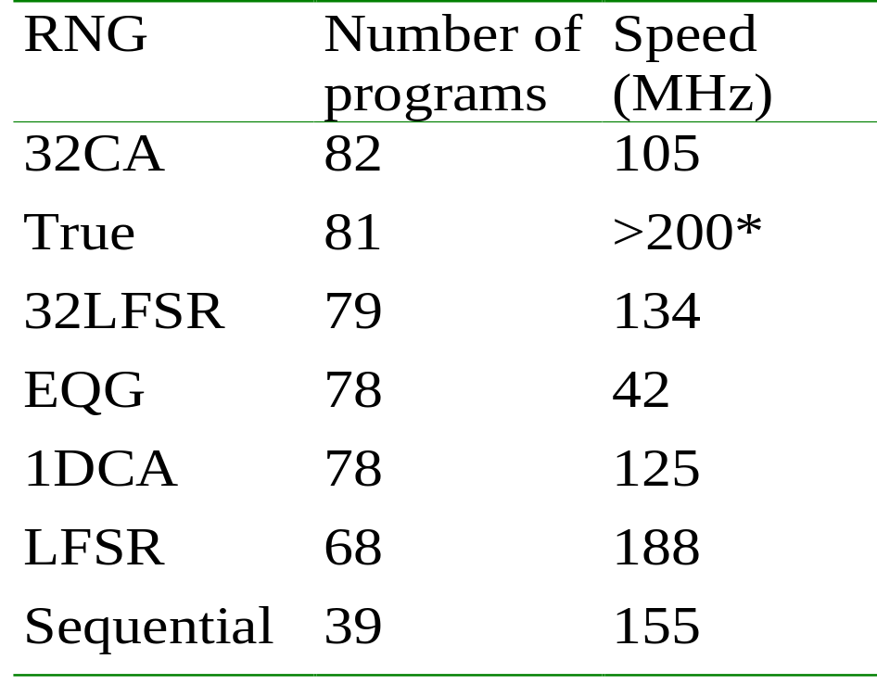
Results - GP
* values obtained ahead of experiment

Slide 14
Summary
Original single LFSR not the best
Multiple LFSR or CA are better
Above a threshold no significant improvement in GP
  agrees with Meysenburg & Foster
Multiply & divide operators slow
Non-random sequences work

Slide 15
Summary
True random source generation can be slow
  for seeding?
Very different Diehard scores give similar GP results
Future work
  More problems
  Combine true RNG with PRNG
  Role of RNG in GP?

